Slide 1


CE-526 Term Project Part 2
Dynamic Timoshenko Simple Frame
•
•
°
•
°
°
•
$$w\left(x,t\right)$$
•
$$ψ\left(x,t\right)$$
°
•
•
°

Slide 2
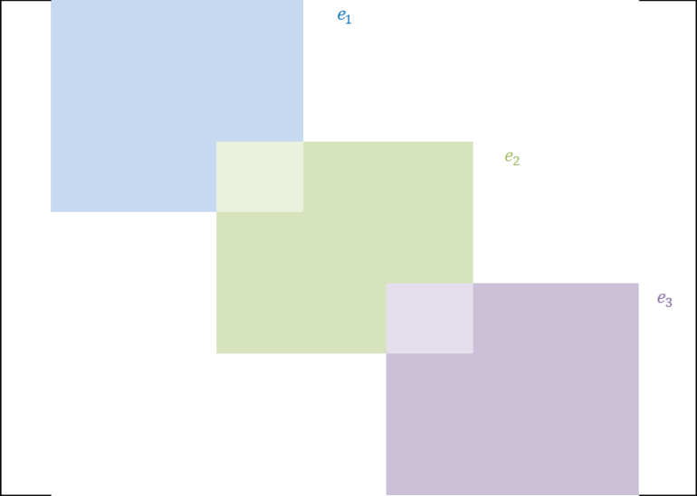










Simple Beam Quadratic Elements
$$e_{1}$$
$$e_{2}$$
$$e_{3}$$
$$e_{4}$$
$$e_{5}$$
$$e_{6}$$
$$e_{7}$$
$$e_{8}$$
$$e_{9}$$
$$e_{10}$$
(1)
(2)
(3)
(4)
(5)
(6)
(7)
(8)
(9)
(10)
(11)
(12)
(13)
(14)
(15)
(16)
(17)
(18)
(19)
(20)
(21)
K1G=zeros(2*n+1);
for i=1:2:2*n-1
K1G(i:i+2,i:i+2)=K1G(i:i+2,i:i+2)+K1E;
end
K1G =

Slide 3
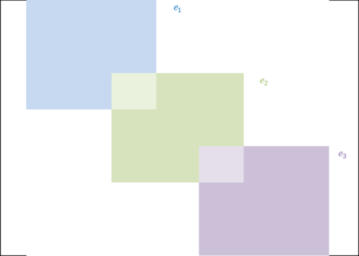

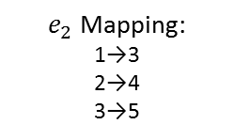


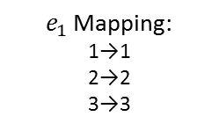


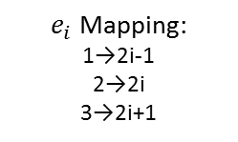



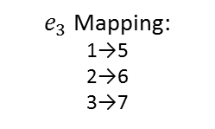
Mapping to Global One Node at a Time
$$e_{1}$$
$$e_{2}$$
$$e_{3}$$
$$e_{4}$$
$$e_{5}$$
$$e_{6}$$
$$e_{7}$$
$$e_{8}$$
$$e_{9}$$
$$e_{10}$$
(1)
(2)
(3)
(4)
(5)
(6)
(7)
(8)
(9)
(10)
(11)
(12)
(13)
(14)
(15)
(16)
(17)
(18)
(19)
(20)
(21)
$e_{1 }$Mapping:
1→1
2→2
3→3
$e_{2}$ Mapping:
1→3
2→4
3→5
$e_{3}$ Mapping:
1→5
2→6
3→7
$e_{i}$ Mapping:
1→2i-1
2→2i
3→2i+1
• • •
k1g=zeros(2*n+1);
for i=1:n
k1g(2*i-1,2*i-1)=k1g(2*i-1,2*i-1)+K1E(1,1);
k1g(2*i,2*i-1)=k1g(2*i,2*i-1)+K1E(2,1);
k1g(2*i+1,2*i-1)=k1g(2*i+1,2*i-1)+K1E(3,1);
k1g(2*i-1,2*i)=k1g(2*i-1,2*i)+K1E(1,2);
k1g(2*i,2*i)=k1g(2*i,2*i)+K1E(2,2);
k1g(2*i+1,2*i)=k1g(2*i+1,2*i)+K1E(3,2);
k1g(2*i-1,2*i+1)=k1g(2*i-1,2*i+1)+K1E(1,3);
k1g(2*i,2*i+1)=k1g(2*i,2*i+1)+K1E(2,3);
k1g(2*i+1,2*i+1)=k1g(2*i+1,2*i+1)+K1E(3,3);
end
K1g =

Slide 4


Extending the Idea to a Simple Frame
$$e_{6}$$
$$e_{7}$$
$$e_{8}$$
$$e_{9}$$
$$e_{10}$$
(11)
(12)
(13)
(14)
(15)
(16)
(17)
(18)
(19)
(20)
(21)
$$e_{5}$$
(10)
(9)
$e_{1 }$Mapping:
1→1
2→2
3→3
$e_{2}$ Mapping:
1→3
2→4
3→5
$e_{3}$ Mapping:
1→5
2→6
3→7
$e_{i}$ Mapping:
1→2i-1
2→2i
3→2i+1
$$e_{4}$$
(8)
• • •
(7)
$$e_{3}$$
(6)
(5)
$$e_{2}$$
(4)
k1g=zeros(2*n+1);
for i=1:n
k1g(2*i-1,2*i-1)=k1g(2*i-1,2*i-1)+K1E(1,1);
k1g(2*i,2*i-1)=k1g(2*i,2*i-1)+K1E(2,1);
k1g(2*i+1,2*i-1)=k1g(2*i+1,2*i-1)+K1E(3,1);
k1g(2*i-1,2*i)=k1g(2*i-1,2*i)+K1E(1,2);
k1g(2*i,2*i)=k1g(2*i,2*i)+K1E(2,2);
k1g(2*i+1,2*i)=k1g(2*i+1,2*i)+K1E(3,2);
k1g(2*i-1,2*i+1)=k1g(2*i-1,2*i+1)+K1E(1,3);
k1g(2*i,2*i+1)=k1g(2*i,2*i+1)+K1E(2,3);
k1g(2*i+1,2*i+1)=k1g(2*i+1,2*i+1)+K1E(3,3);
end
(3)
$$e_{1}$$
(2)
(1)
K1g =

Slide 5
Simulation 1
Simple frame with a pinned column base
•
•
°
•
°
°
•
$$w\left(x,t\right)$$
•
$$ψ\left(x,t\right)$$
°
•
•
°

Slide 6









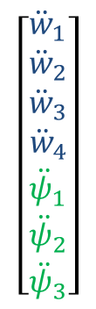


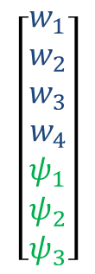



n=number of Elements
$$\left[\begin{aligned}q_{1} \\ q_{2} \\ q_{3} \\ q_{4} \\ 0 \\ 0 \\ 0\end{aligned}\right]$$
$$\overset{̿}{k1}$$
$$\overset{̿}{k2}$$
$$\overline{ w}\left(t\right)$$
$$\overset{̿}{M1}$$
$$\overset{̿}{0}$$
$$\frac{∂^{2}\overline{w}(t) }{∂t^{2}}$$
+
=
$$\overset{̿}{k3}$$
$$\overset{̿}{k4}$$
$$\overline{ ψ}\left(t\right)$$
$$\overset{̿}{0}$$
$$\overset{̿}{M2}$$
$$\frac{∂^{2}\overline{ψ}(t) }{∂t^{2}}$$
[Kst]
[Mst]
[Qst]
3n+1
3n+1
$$\left[\begin{matrix}w_{1} \\ w_{2} \\ w_{3} \\ w_{4} \\ ψ_{1} \\ ψ_{2} \\ ψ_{3}\end{matrix}\right]$$
$$\left[\begin{matrix}{\ddot{w}}_{1} \\ {\ddot{w}}_{2} \\ {\ddot{w}}_{3} \\ {\ddot{w}}_{4} \\ {\ddot{ψ}}_{1} \\ {\ddot{ψ}}_{2} \\ {\ddot{ψ}}_{3}\end{matrix}\right]$$
$$\left[\begin{aligned}q_{1} \\ q_{2} \\ q_{3} \\ q_{4} \\ 0 \\ 0 \\ 0\end{aligned}\right]$$
+
=
2n+1
2n+1

Slide 7
Simulation 2
Simple frame with a fixed column base
•
•
°
•
°
°
•
$$w\left(x,t\right)$$
•
$$ψ\left(x,t\right)$$
°
•
•
°

Slide 8
n=number of Elements
$$\left[\begin{aligned}q_{1} \\ q_{2} \\ q_{3} \\ q_{4} \\ 0 \\ 0 \\ 0\end{aligned}\right]$$
$$\overset{̿}{k1}$$
$$\overset{̿}{k2}$$
$$\overline{ w}\left(t\right)$$
$$\overset{̿}{M1}$$
$$\overset{̿}{0}$$
$$\frac{∂^{2}\overline{w}(t) }{∂t^{2}}$$
+
=
$$\overset{̿}{k3}$$
$$\overset{̿}{k4}$$
$$\overline{ ψ}\left(t\right)$$
$$\overset{̿}{0}$$
$$\overset{̿}{M2}$$
$$\frac{∂^{2}\overline{ψ}(t) }{∂t^{2}}$$
[Kst]
[Mst]
[Qst]
3n+1
3n+1
$$\left[\begin{matrix}w_{1} \\ w_{2} \\ w_{3} \\ w_{4} \\ ψ_{1} \\ ψ_{2} \\ ψ_{3}\end{matrix}\right]$$
$$\left[\begin{matrix}{\ddot{w}}_{1} \\ {\ddot{w}}_{2} \\ {\ddot{w}}_{3} \\ {\ddot{w}}_{4} \\ {\ddot{ψ}}_{1} \\ {\ddot{ψ}}_{2} \\ {\ddot{ψ}}_{3}\end{matrix}\right]$$
$$\left[\begin{aligned}q_{1} \\ q_{2} \\ q_{3} \\ q_{4} \\ 0 \\ 0 \\ 0\end{aligned}\right]$$
+
=
2n+1
2n+1

Slide 9
Extending the Idea to a More Complex Frame

Slide 10
 | 1 | 2 | 3 | 4 | 5 | 6 | 7 | 8 | 9 | 10 | 11 | 12
1 | e₁₁ | e₁₂ | e₁₃
2 | e₂₁ | e₂₂ | e₂₃
3 | e₃₁ | e₃₂ | e₃₃+e₁₁ + e₁₁ | e₁₂ | e₁₃ |  |  |  | e₁₃ |  |  | e₁₂
4 |  |  | e₂₁ | e₂₂ | e₂₃
5 |  |  | e₃₁ | e₃₂ | e₃₃+e₁₁ | e₁₂ | e₁₃
6 |  |  |  |  | e₂₁ | e₂₂ | e₂₃
7 |  |  |  |  | e₃₁ | e₃₂ | e₃₃+e₁₁ | e₁₂ | e₁₃
8 |  |  |  |  |  |  | e₂₁ | e₂₂ | e₂₃
9 |  |  | e₃₁ |  |  |  | e₃₁ | e₃₂ | e₃₃+e₁₁ + e₃₃ | e₁₂ | e₁₃ | e₃₂
10 |  |  |  |  |  |  |  |  | e₂₁ | e₂₂ | e₂₃
11 |  |  |  |  |  |  |  |  | e₃₁ | e₃₂ | e₃₃
12 |  |  | e₂₁ |  |  |  |  |  | e₂₃ |  |  | e₂₂

Slide 11
n=number of Elements
$$\left[\begin{aligned}q_{1} \\ q_{2} \\ q_{3} \\ q_{4} \\ 0 \\ 0 \\ 0\end{aligned}\right]$$
$$\overset{̿}{k1}$$
$$\overset{̿}{k2}$$
$$\overline{ w}\left(t\right)$$
$$\overset{̿}{M1}$$
$$\overset{̿}{0}$$
$$\frac{∂^{2}\overline{w}(t) }{∂t^{2}}$$
+
=
$$\overset{̿}{k3}$$
$$\overset{̿}{k4}$$
$$\overline{ ψ}\left(t\right)$$
$$\overset{̿}{0}$$
$$\overset{̿}{M2}$$
$$\frac{∂^{2}\overline{ψ}(t) }{∂t^{2}}$$
[Kst]
[Mst]
[Qst]
3n
3n
$$\left[\begin{matrix}w_{1} \\ w_{2} \\ w_{3} \\ w_{4} \\ ψ_{1} \\ ψ_{2} \\ ψ_{3}\end{matrix}\right]$$
$$\left[\begin{matrix}{\ddot{w}}_{1} \\ {\ddot{w}}_{2} \\ {\ddot{w}}_{3} \\ {\ddot{w}}_{4} \\ {\ddot{ψ}}_{1} \\ {\ddot{ψ}}_{2} \\ {\ddot{ψ}}_{3}\end{matrix}\right]$$
$$\left[\begin{aligned}q_{1} \\ q_{2} \\ q_{3} \\ q_{4} \\ 0 \\ 0 \\ 0\end{aligned}\right]$$
+
=
2n
2n

Slide 12
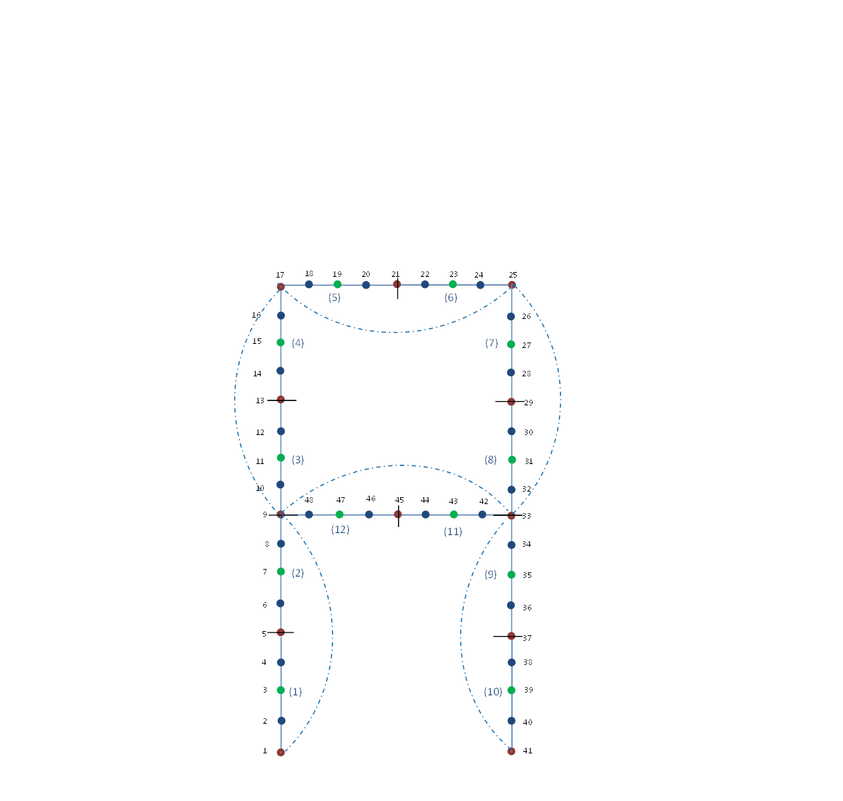
Simulation 3
Frame with cross beam

Slide 13
Cubic Only

Slide 14
Quadratic Only

Slide 15
Quadratic rotation and Cubic Displacement

